Slide 1


A Presentation on BIG DATA
Affiliated to Purbanchal University
An Undertaking of Bhaktapur Municipality
KHWOPA ENGINEERING
COLLEGE
Our Team:-
Kajol Dhaubanjar
Nabin Hyanmikha
Sanjay Jonchhe
Sujan Khyaju
Sujan Manandhar
Susan Sujakhu

Slide 2
CONTENTS
Introduction
Data Growth
Source of Data
Introduction to Big Data
Characteristics
Challenges to Managing Big Data
Benefits
Applications
Approach to Process Big Data
Data Never Ends

Slide 3
INTRODUCTION
Data:-
Raw facts which needs to be interpreted to derive meaning.
Processed within a context into usable format to extract information.
May be numbers, characters, symbols, images and many more.

Slide 4
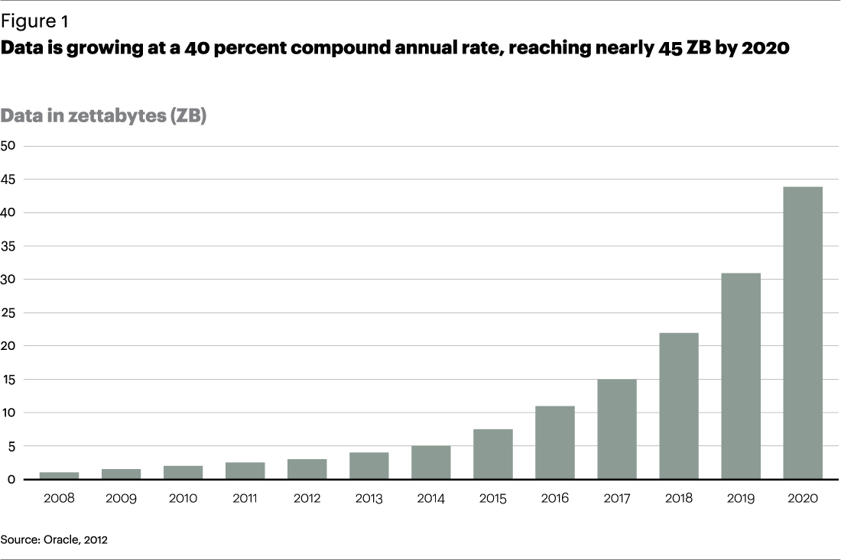
DATA GROWTH

Slide 5
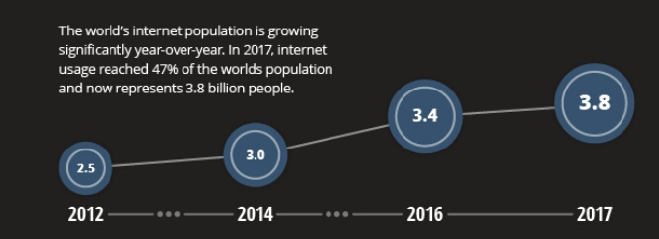
DATA GROWTH

Slide 6
SOURCE OF DATA
IoT (Internet of Things)
Social Media
Sensors
Official Statistics
Transaction
Customer created texts

Slide 7


Slide 8
INTRODUCTION to BIG DATA
Huge volume of structured and un-structured data that is difficult to process using traditional database.

Slide 9
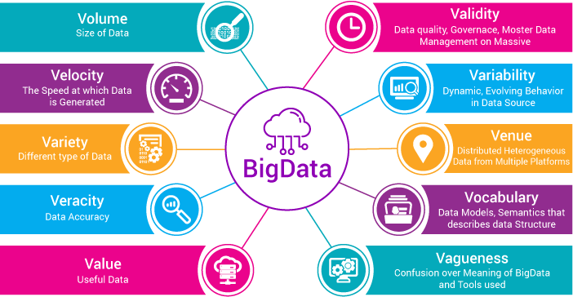
CHARACTERISTICS

Slide 10
CHALLENGES TO MANAGING BIG DATA
Developing infrastructure
Minimizing cost
Maintaining security
Preventing corruption
Flexible Scale
Accessible User interface
Clean Accessibility
Compatibility

Slide 11
BENEFITS
Vast amount of data
Cost savings
Time reductions
New product development
Prediction and decision making
Helps gain insights

Slide 12
APPLICATIONS
Contributions to Learning
Contributions to Healthcare
Contributions in Private sector
Contributions to Communications, Media and Entertainment
Weather patterns
Contributions to Banking Zones and Fraud Detection

Slide 13
APPROACH TO PROCESS BIG DATA
HADOOP:-
Open source frame work which has been used by Apache Software Foundation.
Store huge data set and process huge data set within cluster of commodity hardware.

Slide 14
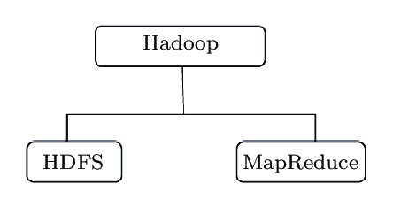
Components of HADOOP:-

Slide 15
HDFS:-
Hadoop distributed file system.
Technique to store huge data with cluster of commodity hardware.
Data is broken into small chunks and stored, distributed on different nodes in cluster
MapReduce
Technique to process data storing in HDFS.
Client needs to submit algorithm to the master nodes to process the data.

Slide 16
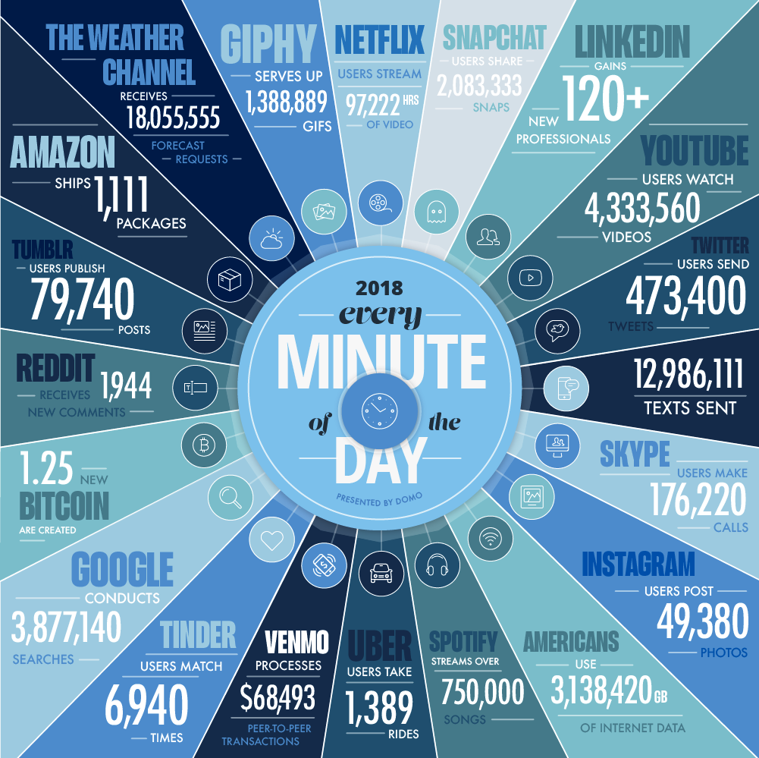
DATA NEVER ENDS

Slide 17
THANK YOU !!!

